Slide 1




MPRASHANT
OVERVIEW O
AWS
F

Slide 2

AWS offers a vast range of services, including compute power, storage solutions, networking, databases, and much more.
MPRASHANT

Slide 3
It offers a pay-as-you-go model, allowing you to pay only for what you use, which is ideal for optimizing costs
MPRASHANT

Slide 4
AWS was launched in 2006 as the first public cloud platform
MPRASHANT

Slide 5
Started with Amazon S3 for storage and EC2 for compute power.
MPRASHANT
Now expanded into offering over 200 fully- featured services across various domains like AI, machine learning, IoT, and more...

Slide 6
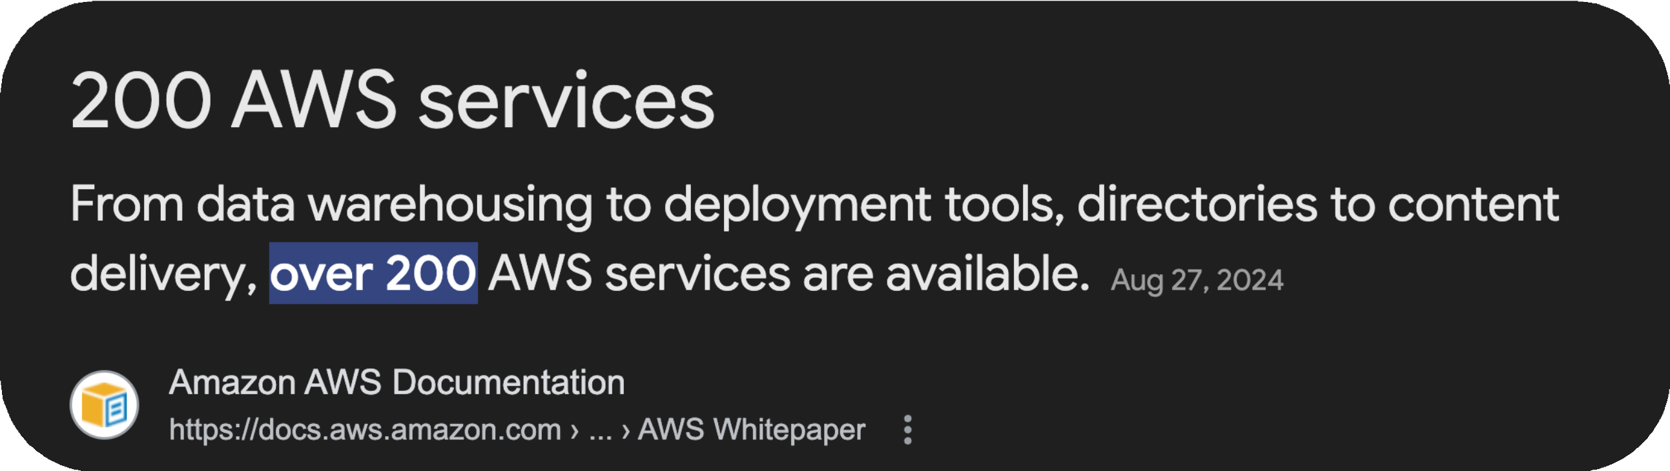

Slide 7
What makes AWS so special?
MPRASHANT
Scalability, Global Reach, Reliability, Security

Slide 8
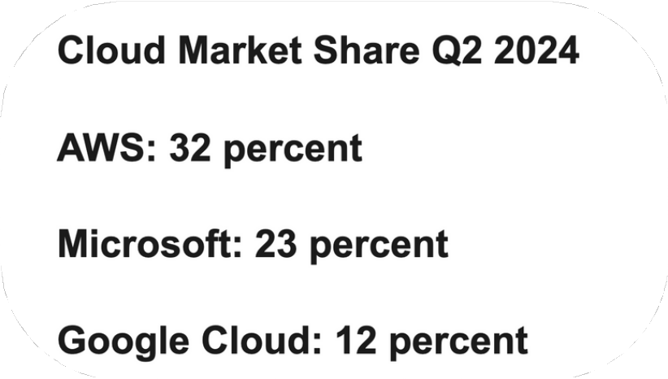
AWS in the Present Market
MPRASHANT
As per CRN report

Slide 9
AWS in the Present Market
MPRASHANT
As per CRN report

Slide 10

Popular Services Provided by AWS
MPRASHANT
Most popular ones include EC2 for scalable compute capacity, S3 for highly reliable storage, RDS for managed databases, Lambda for serverless computing, and CloudFront for content delivery.

Slide 11
Cloud Engineer Solutions Architect DevOps Engineer Cloud Developer Data Engineer
Cloud Security Specialist Machine Learning Engineer Cloud Consultant
MPRASHANT
AWS Support Engineer / Cloud Support Associate
Site Reliability Engineer (SRE)

Slide 12
AWS Account Setup

Slide 13
